Slide 1

Alpen Bank In Romania
Authors: Aleksandre Chiqobava,Natia Bliadze and Murtaz Putkaradze

Slide 2
Market Environment
Political
Economic
Technology
Social

Slide 3
SWOT Analysis
Strengths
Weaknesses
Opportunity
Treats

Slide 4




Customer Analysis
46,1% can afford Credit cards
Middle class with €3,000-4500 year
income and 18,2%
Affluent with €4500-6000 year
income and 15%
Most Affluent with €6000-More year
income and 12,9%

Slide 5
Customer Analysis
Middle class makes €60.03 revenue year and 39.5%
Affluent makes €123.38 revenue year and 32.4%
Most Affluent makes €209.78 revenue year income and 28%

Slide 6



Action Plan
Goals:
Launch a credit card
Reach the affluent and most affluent
Launch marketing and adverting that appeals to our audience Action Steps:
Short term and Long-term

Slide 7


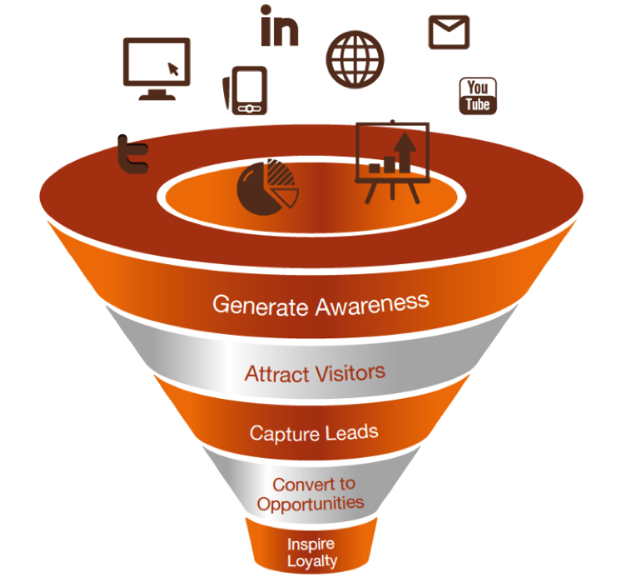
Short term
Marketing Plan
Direct Sales and
Branch-Cross Sell
TV, Magazine and
Media Adverts
Launch of promotional events by the Alpen Bank’s public relations department.
Evening events could be held at elegant local venues for charitable fundraising purposes.

Slide 8

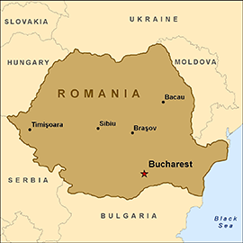

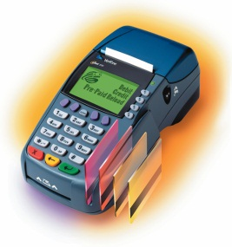
Long Term
•Continuing growth in the Romanian market, with special focus on the credit card market.
•Attracting customers to Alpen Bank by focusing on its premium image and superior services.
•Expansion in the credit card market, to have established a customer base of 200,000 customers five years following initial launch.
•As the Romanian economy is growing, the percentage of population with a disposable income is increasing. Alpen Bank will focus on attracting new members of the affluent segment of the population.
•Increase the lifetime value of each customer, by further expansion of the financial services offered.
•Increase credit card utilization by informing clientele of benefits associated with credit card purchases, along with temporary potential incentives offered in order to change consumer habits.

Slide 9

Position to the Market
Affluent Customer is 10% Of population and 24% wealth
Less Price Sensitive
Career Oriented,
Professionals
Using Credit Card frequently

Slide 10
Analyzing the financial data provided to us in the case.
Target Segment | Annual Income | % of Potential Card holders | Potential Card Holders | Annual Revenue | Total Revenue
Middle Class | 3000-4000 | 18,2 | 3’385’200 | 60,63 | 2’052’444’676
Affluent | 4500-6000 | 15 | 2’790’000 | 123,38 | 3’444’230’200
Most Affluent | 6000+ | 12,9 | 2’399’400 | 209,75 | 503’274’150
8’574’600 |  | 1’052’749’026
Revenue Per Card Holder = 1’052’749’026/8’574’600 = 122,78
(All Three Classes)
Revenue Per Card Holder = 847’504’350/5’189’400= 163,36
(Affluent + Most Affluent)
Total Population Qualify for credit Card = 18.6million

Slide 11
Customer Acquisition for All Customers
 | Unit Cost | Prospect Reached | Response Rate | Qualification Rate | Conversion Rate | N of Customers | Total Cost | Cost Per Customer
Direct Mail | 0,50 | 2’500’000 | 3% | 60% | 85% | 38’250 | 1’250’000 | 32,68
Take One | 0,10 | 2’000’000 | 2,5% | 30% | 85% | 12’750 | 200’000 | 15,69
FSIs | 0,05 | 3’500’000 | 1,5% | 30% | 85% | 13’388 | 175’000 | 13,07
Direct Sales | 3000/rep | 60’000 | 25% | 60% | 85% | 7’650 | 3’000 | 3,92
Branch Cross-sell | 1 | 50’000 | 50% | 90% | 85% | 19’125 | 50’000 | 2,61
*No.of Customer= 2500000 * 0.03 *0.60* 0.85
91’163 1’710’000
Cost Per Customer=Total Cost/N of Customers
=18.75
1710000/91163
58’969 1’080’000
In case of Affluent Class the Number of Customer will be reduced by
50% for Direct Mail, Take One and FSIs so the cost per customer for Affluent class will be = 18.31

Slide 12
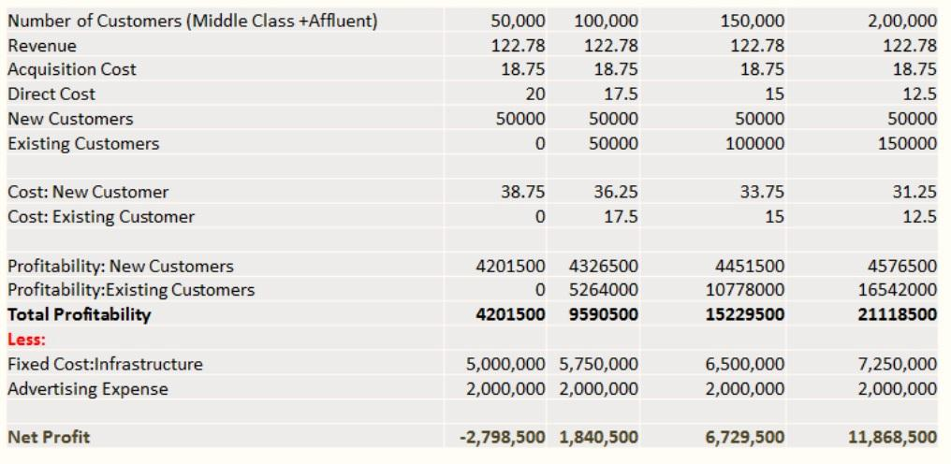
Break Even (Middle and Affluent)
So now we can calculate the breakeven. X in the following formulae is assumed to be additional customers.
122.78 ( X+ 50,000) – ( 5,750,000+2,000,000) – ( 50,000*17.5 + 36.25*X) =0 X= 28,758
Break Even = 50,000+ 28,758= 78,758
to identify the no. customer at which we get 5million profit we develop the following formula
122.78( X+100,000)- ( 650,000+2,000,000) – ( 100,000*15 + 33.75*Y) = 5,000,000
No. Of Customer =130,574

Slide 13
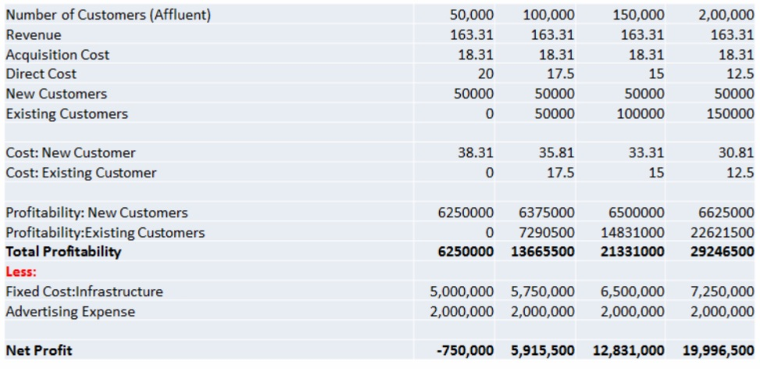
Break Even (Affluent)
We apply the same process to the affluent class. Break Even: 163.31( X+ 50,000) – ( 5,750,000 + 2,000,000) – ( 50000* 17.5 + 35.81* X) = 0 X= 3,604 Break Even = 53,604 Revenue Analysis: 163.31 ( X+50,000) – ( 6,500,000 + 2,000,000) – ( 15*100,000 + 35.81* X)= 5,000,000 X=42,820 No. of Customer = 92,820

Slide 14

Conclusion
Member Of
European Union
Less
Risky
Grow
Potential

